Slide 1

Containers & workflow pipelines for automated and reproducible data analysis
29 March 2021
Alexander Botzki
Tuur Muyldermans
Materials & slides are accessible in this repository.

Slide 2


Slide 3

To reproduce the result of a typical computational biology paper requires 280 hours
≈ 1.7 months!
from: https://www.youtube.com/watch?v=8_i8Tn335X0&ab_channel=Nextflow

Slide 4


Slide 5
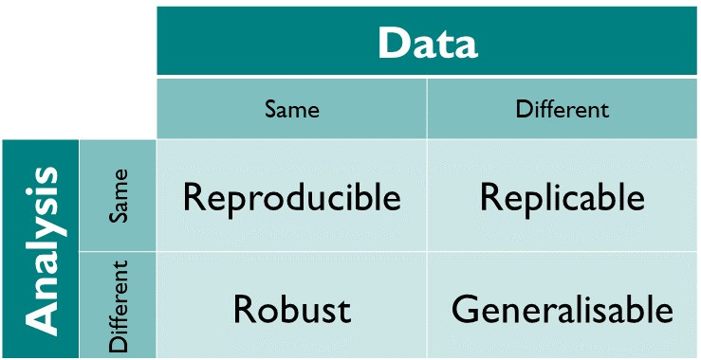
What is reproducibility?
Reproducibility: Same data, same analysis, same results.
Source: https://the-turing-way.netlify.app/reproducible-research/overview/overview-definitions.html

Slide 6
Linux script - workflow
> run_alignment.sh
#!/bin/bash
### Alignmemt
# Align the reads to the reference genome
bwa aln $genome $fq > $sai
# Convert the output to the SAM format
bwa samse $genome $sai $fq > $sam
# Convert the SAM file to BAM format
samtools view -S -b $sam > $bam
# Sort the BAM file
samtools sort $bam -o $sorted_bam

Slide 7






Workflow pipelines
Long list of possibilities: https://github.com/pditommaso/awesome-pipeline/

Slide 8
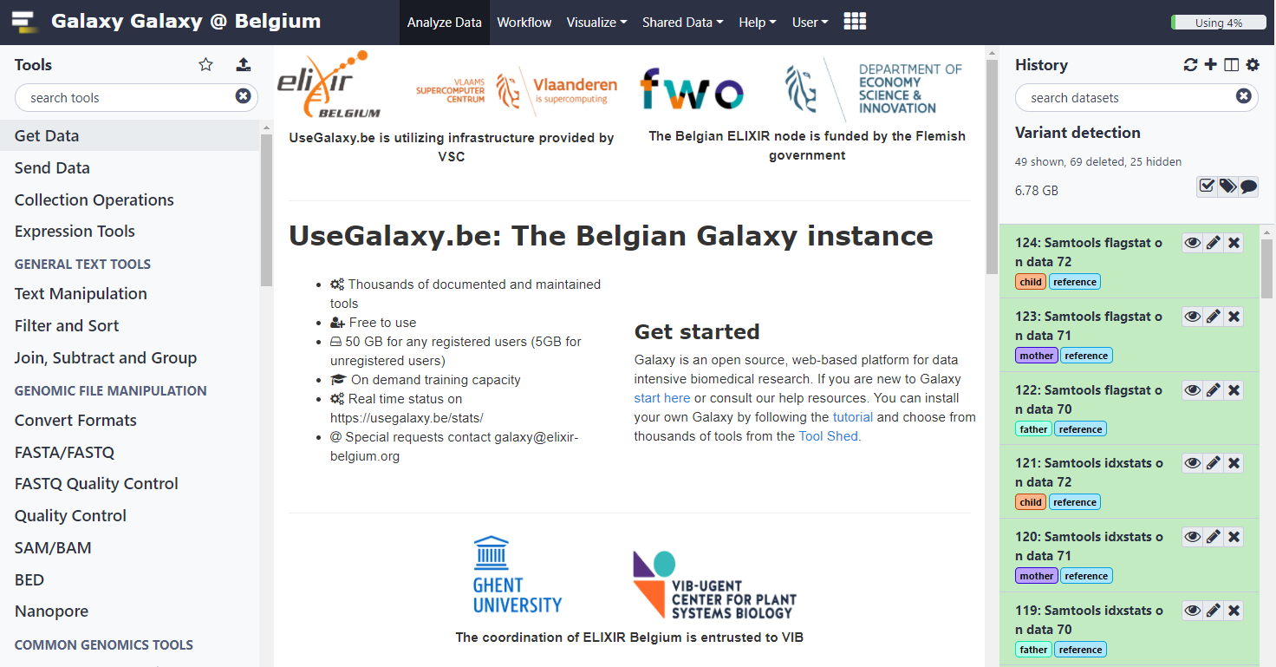
UseGalaxy.*

Slide 9


Nextflow
Data-driven computational pipelines
Enables scalable and reproducible scientific workflows using software containers

Slide 10
Why (not)? (1/2)
Scalability
Portability
Reproducible
Re-usability
Community

Slide 11
Why (not)? (2/2)
Syntax of the Groovy language, yet another language
Flexibility also comes with cost of complexity
Nitpicking details in failure of scripts

Slide 12
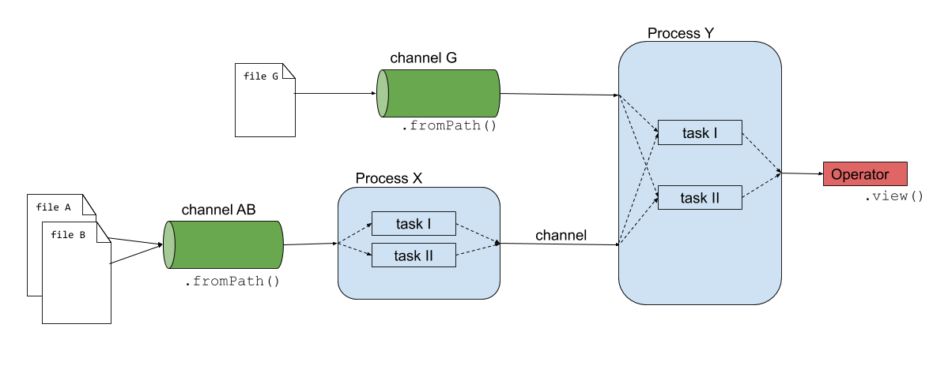
Building blocks

Slide 13
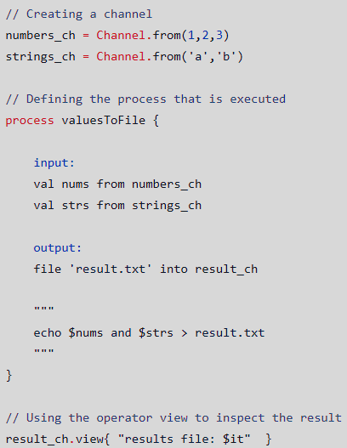
Building blocks
Channels
Input of the analysis
Can be used by operators or processes
Processes
In any language (bash, Python, Ruby, etc.)
Executed independently
Isolated from any other process
Unidirectional async FIFO queues
Operators
Transform content of channels
Only handful are used extensively

Slide 14
Building blocks
Run a pipeline:
Output:
nextflow run firstscript.nf
N E X T F L O W ~ version 20.10.0
Launching `firstscript.nf` [disturbed_tuckerman] - revision: 5d78f867ff
executor > local (2)
[72/e12dbd] process > valuesToFile (1)
[c9/07b95c] process > valuesToFile (2)
results file: /path/to/work/72/e12dbd0f6e972fd8faa1101a68e8db/result.txt
results file: /path/to/work/c9/07b95ceb2a18dbebabc653e0cec0ae/result.txt

Slide 15
Building blocks

Slide 16
Building blocks
Modules
Write processes in a module
Import module into main pipeline script
Example:
Or:
include { fastqc } from "${launchDir}/modules/fastqc"
include { star_idx; star_alignment } from "${launchDir}/modules/star"

Slide 17
nextflow run main.nf --reads …
> main.nf
#!/usr/bin/env nextflow
params.reads = "$launchDir/data/*{1,2}.fq.gz"
read_pairs_ch = Channel.fromFilePairs(params.reads, checkIfExists:true)
include { fastqc } from "${launchDir}/modules/fastqc"
...
> modules/fastqc.nf
#!/usr/bin/env nextflow
process fastqc {
input:
tuple val(sample), path(reads)
output:
path("*_fastqc.{zip,html}"), emit: fastqc_out
script:
"""
fastqc ${reads}
"""
}

Slide 18
Building blocks
Workflows
Use processes as functions (e.g. fastqc)
Sub-workflows
// Running a workflow with the defined processes here.
workflow {
// QC on raw reads
fastqc(read_pairs_ch)
// Indexing of reference genome
star_idx(genome, gtf)
}

Slide 19
> main.nf
#!/usr/bin/env nextflow
params.reads = "$launchDir/data/*{1,2}.fq.gz"
read_pairs_ch = Channel.fromFilePairs(params.reads, checkIfExists:true)
include { fastqc } from "${launchDir}/modules/fastqc"
workflow {
fastqc(read_pairs_ch)
}
> modules/fastqc.nf
#!/usr/bin/env nextflow
process fastqc {
input:
tuple val(sample), path(reads)
output:
path("*_fastqc.{zip,html}"), emit: fastqc_out
script:
"""
fastqc ${reads}
"""
}

Slide 20
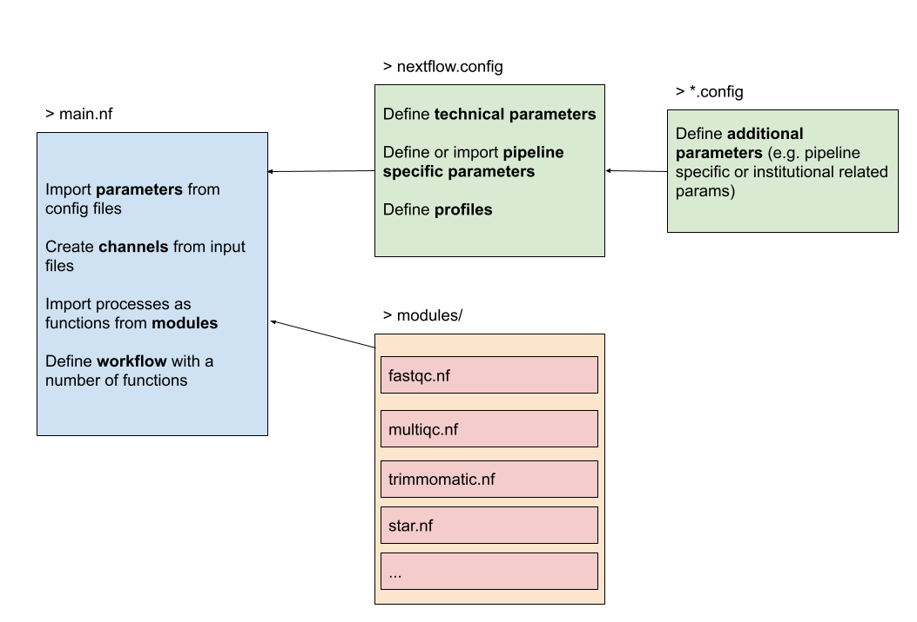
Overview

Slide 21
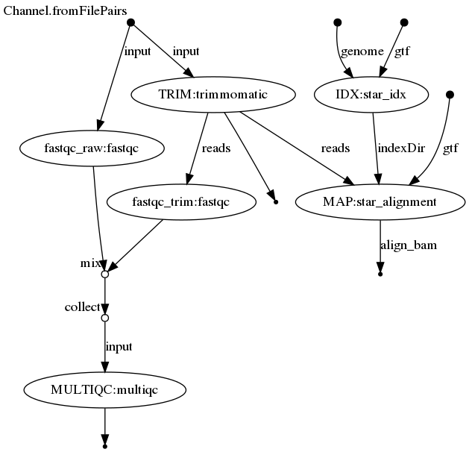
Example pipeline
Partially bulk RNA-seq analysis
QC, trimming, mapping (indexing)

Slide 22
Configurations
Pipeline configuration properties are defined in nextflow.config
Technical parameters:
Executor, CPUs, memory, etc.
Pipeline specific parameters:
Input files, process related parameters (e.g. trimmomatic or STAR)
Separate these variables from pipeline - more modular
params.reads = "$launchDir/data/*{1,2}.fq.gz"
process {
memory='1G'
cpus='1'
}

Slide 23
Configurations – pipeline specific parameters
Separate tool parameters in a separate file
One separate file for all parameters used by the pipeline
One file per tool used in the pipeline (example)
includeConfig "/path/to/params.config"
// Define project parameters needed for running the pipeline
params {
// Trimmomatic
slidingwindow = "SLIDINGWINDOW:4:15"
avgqual = "AVGQUAL:30"
// Star
threads = 2
genomeSAindexNbases = 10
lengthreads = 98
indexpath = "${refdir}/index/"
}

Slide 24
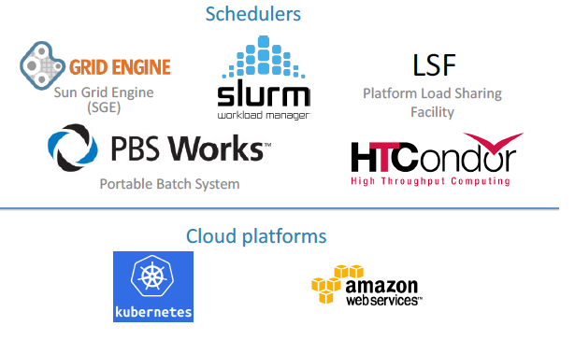

Configurations – technical parameters
Execution abstraction
Executor determines how the script is run on the target system
By default: locally
Alternatively: HPC or cloud platforms

Slide 25
Configurations – technical parameters
Define process executors in profiles and choose them on run-time
// Define technical resources below:
profiles {
standard {
process {
executor = 'local’
}
}
azure {
process {
executor = 'azurebatch'
}
}
}
nextflow run main.nf
nextflow run main.nf –profile azure
https://www.nextflow.io/docs/edge/executor.html#

Slide 26
Configurations – technical parameters
Add labels to optimize local run-time
> nextflow.config
> modules/fastqc.nf
// Define technical resources below:
profiles {
standard {
process {
executor = 'local'
withLabel: 'low' {
memory='1G'
cpus='1'
time='6h'
}
withLabel: 'med' {
memory='2G'
cpus='2'
}
}
}
}
#!/usr/bin/env nextflow
process fastqc {
label 'low'
input:
tuple val(sample), path(reads)
output:
path("*_fastqc.{zip,html}"), emit: fastqc_out
script:
"""
fastqc ${reads}
"""
}

Slide 27




Configurations – technical parameters
Tools & their versions

Slide 28
Configurations – technical parameters
Portability & reproducibility
Support for Conda, Docker & Singularity
Create a (containerized) environment with all tools installed
Create a (containerized) environment for each tool

Slide 29
Configurations – technical parameters
> nextflow.config
> modules/fastqc.nf
// Define technical resources below:
profiles {
standard {
process {
executor = 'local’
}
}
azure {
process {
executor = 'azurebatch'
}
}
conda { params.enable_conda = true }
docker { docker.enabled = true }
}
#!/usr/bin/env nextflow
process fastqc {
label 'low'
container 'quay.io/biocontainers/fastqc:0.11.9--0'
input:
tuple val(sample), path(reads)
output:
path("*_fastqc.{zip,html}"), emit: fastqc_out
script:
"""
fastqc ${reads}
"""
}
nextflow run main.nf –profile azure,docker

Slide 30

Configurations
Containers are generally more up-to-date
Find containers on quay.io or dockerhub

Slide 31
Reports
Directed Acyclic Graph
nextflow run main.nf –profile azure,docker –with-dag

Slide 32
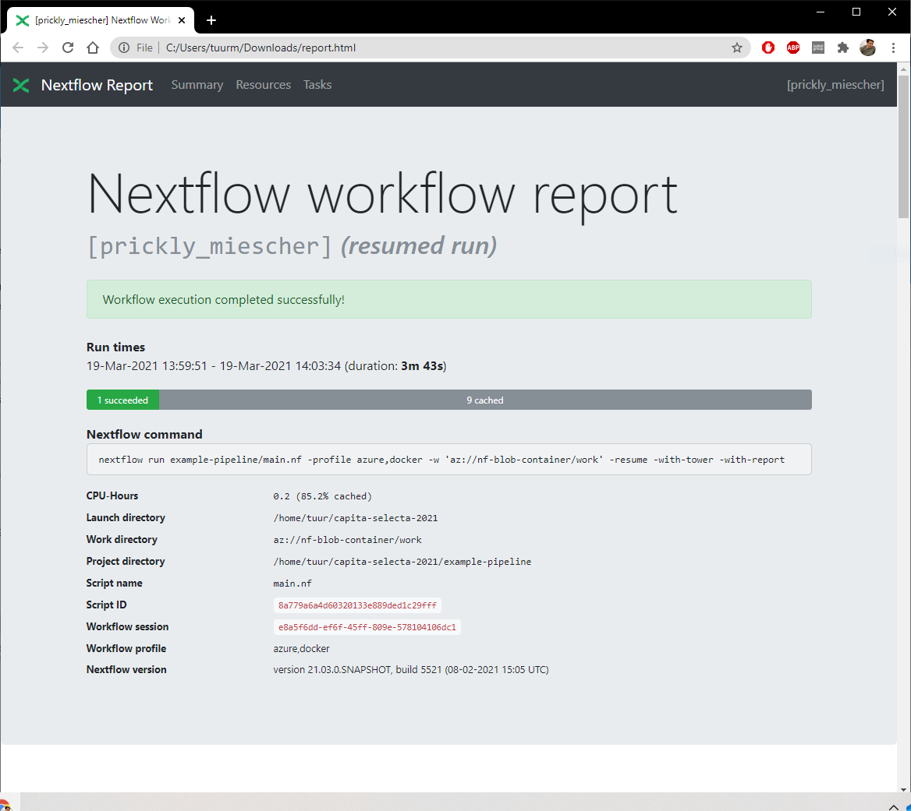
Reports
Directed Acyclic Graph
Html-report
nextflow run main.nf –profile azure,docker –with-report

Slide 33
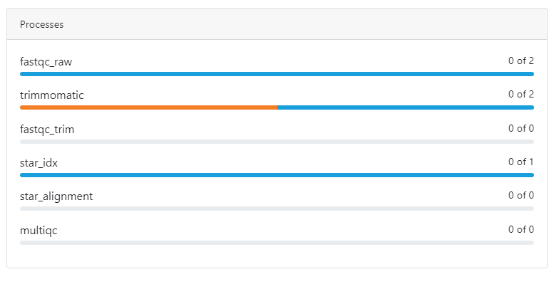
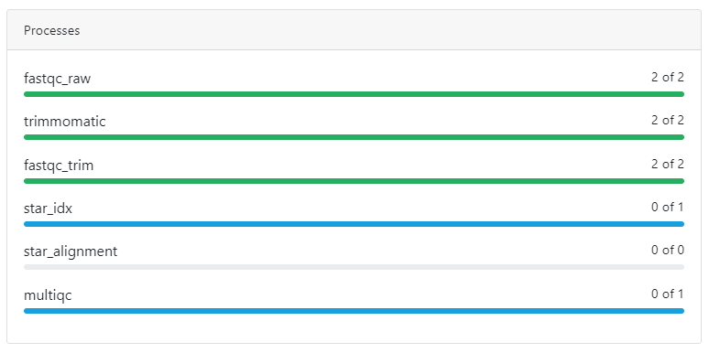
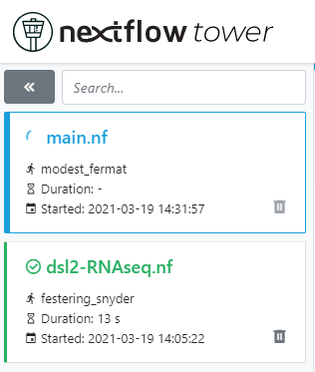
NF-tower
tower.nf
nextflow run main.nf –profile azure,docker –with-tower

Slide 34
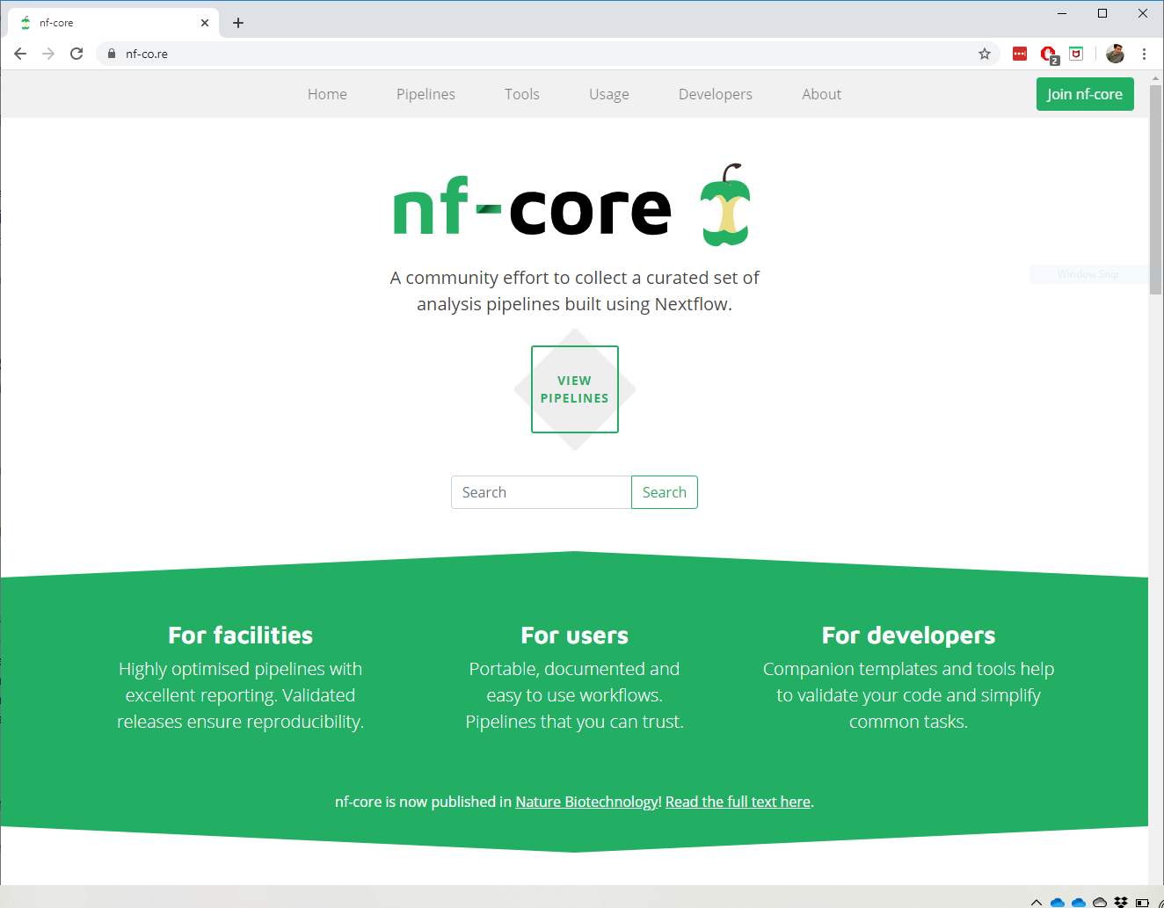
Triggered for more?
Learning to write your own workflow pipeline:
Containers & workflow pipelines for reproducible and automated data analysis – 2d workshop
Re-using high-level workflow pipelines in a variety of topics:

Slide 35
Containers as cornerstone of reproducible data-analysis
Link to the materials

